Slide 1



































$$GPIO18$$
$$V_{REF}$$
$$V_{DD}$$
$$V_{REF}$$
$$V_{DD}$$
$$V_{REF}$$
$$V_{DD}$$
$$GPIO19$$
$$GPIO23$$
$$IN+$$
$$CLK$$
$$IN+$$
$$CLK$$
$$IN+$$
$$CLK$$
$$GPIO24$$
MCP3201
MCP3201
MCP3201
$$IN−$$
$$D_{OUT}$$
$$IN−$$
$$D_{OUT}$$
$$IN−$$
$$D_{OUT}$$
Pi Wedge
$$GPIO25$$
$$V_{SS}$$
$$CS/SHDN$$
$$V_{SS}$$
$$CS/SHDN$$
$$V_{SS}$$
$$CS/SHDN$$
$$3.3V$$
Filter
$$GND$$
$$GPIO26$$
$$GPIO27$$
$$V_{REF}$$
$$V_{DD}$$
$$V_{REF}$$
$$V_{DD}$$
$$IN+$$
$$CLK$$
$$IN+$$
$$CLK$$
Raspberry Pi
MCP3201
MCP3201
$$IN−$$
$$D_{OUT}$$
$$IN−$$
$$D_{OUT}$$
$$ETH$$
$$V_{SS}$$
$$CS/SHDN$$
$$V_{SS}$$
$$CS/SHDN$$
$$SSH$$
Ekstern PC
Blokkskjema av raspberry og ADC

Slide 2
R
R
R
R
R
Signalgenerator
MCP3201
MCP3201
MCP3201
MCP3201
MCP3201
IN+
IN+
IN+
IN+
IN+
I/O
I/O
I/O
I/O
I/O
I/O
I/O
I/O
I/O
I/O
Raspberry Pi
Blokkskjema av raspberry og ADC

Slide 3




















Blokkskjema av heile kretsen
$$GPIO18$$
$$V_{REF}$$
$$V_{DD}$$
$$V_{REF}$$
$$V_{DD}$$
$$V_{REF}$$
$$V_{DD}$$
$$GPIO19$$
$$GPIO23$$
$$IN+$$
$$CLK$$
$$IN+$$
$$CLK$$
$$IN+$$
$$CLK$$
$$GPIO24$$
MCP3201
MCP3201
MCP3201
$$IN−$$
$$D_{OUT}$$
$$IN−$$
$$D_{OUT}$$
$$IN−$$
$$D_{OUT}$$
Pi Wedge
$$GPIO25$$
$$V_{SS}$$
$$CS/SHDN$$
$$V_{SS}$$
$$CS/SHDN$$
$$V_{SS}$$
$$CS/SHDN$$
$$3.3V$$
Filter
$$GND$$
$$GND$$
$$V_{CC}$$
$$OUT$$
$$GND$$
$$V_{CC}$$
$$OUT$$
$$GND$$
$$V_{CC}$$
$$OUT$$
Raspberry Pi
Mikrofon 1
Mikrofon 2
Mikrofon 3
$$ETH$$
$$SSH$$
Ekstern PC

Slide 4
Blokkskjema av heile kretsen
$$GPIO18$$
$$V_{REF}$$
$$V_{DD}$$
$$V_{REF}$$
$$V_{DD}$$
$$V_{REF}$$
$$V_{DD}$$
$$GPIO19$$
$$GPIO23$$
$$IN+$$
$$CLK$$
$$IN+$$
$$CLK$$
$$IN+$$
$$CLK$$
ADC1
ADC2
ADC3
$$GPIO24$$
$$IN−$$
$$D_{OUT}$$
$$IN−$$
$$D_{OUT}$$
$$IN−$$
$$D_{OUT}$$
Pi Wedge
$$GPIO25$$
$$V_{SS}$$
$$CS/SHDN$$
$$V_{SS}$$
$$CS/SHDN$$
$$V_{SS}$$
$$CS/SHDN$$
$$3.3V$$
Filter
$$GND$$
$$GND$$
$$V_{CC}$$
$$OUT$$
$$GND$$
$$V_{CC}$$
$$OUT$$
$$GND$$
$$V_{CC}$$
$$OUT$$
Raspberry Pi
Mikrofon 1
Mikrofon 2
Mikrofon 3
$$ETH$$
$$SSH$$
Ekstern PC

Slide 5

Overordna blokkskjema
Raspberry Pi
Lyd
Mikrofon 1
ADC
I/O
Lyd
Mikrofon 2
ADC
I/O
Lyd
Mikrofon 3
ADC
I/O

Slide 6







En ADC til RPI
$$3.3V$$
$$V_{REF}$$
$$V_{DD}$$
Raspberry Pi
$$GPIO$$
$$IN+$$
$$CLK$$
$$GPIO$$
MCP3201
$$GPIO$$
$$IN−$$
$$D_{OUT}$$
$$GND$$
$$V_{SS}$$
$$CS/SHDN$$

Slide 7



Figur av viklane til mikrofonen (trekanten) (Figur mikrofoner og forklaring av tidsdifferansene)
Kondensatorer på én ADC
Lyd
$$V_{REF}$$
$$V_{DD}$$
$$τ_{21}$$
1
$$τ_{31}$$
$$IN+$$
$$CLK$$
MCP3201
θ
$$IN−$$
$$D_{OUT}$$
$$V_{SS}$$
$$CS/SHDN$$
2
$$τ_{32}$$
3

Slide 8


Punkt 1
Lyd
$$τ_{1}$$
θ
1
2
-θ
Lyd
$$τ_{2}$$
Punkt 2

Slide 9







$$\vec{b}$$
$$y$$
1
$${\vec{d}}_{21}$$
$${\vec{d}}_{31}$$
θ
$$a$$
2
3
$${\vec{d}}_{32}$$
$$x$$

Slide 10
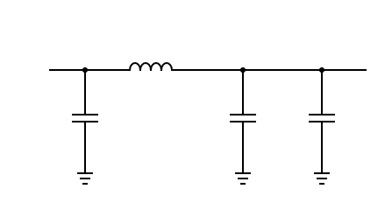











Kretsskjema for filteret
$$L$$
$$V_{ut}$$
$$V_{in}$$
$$Z_{1}$$
$$C_{1}$$
$$C_{2}$$
$$C_{3}$$
$$Z_{4}$$
$V_{in}$=3.3V
$$100mH$$
$V_{ut}$ =3.3V
100µF
470µF
100nF

Slide 11
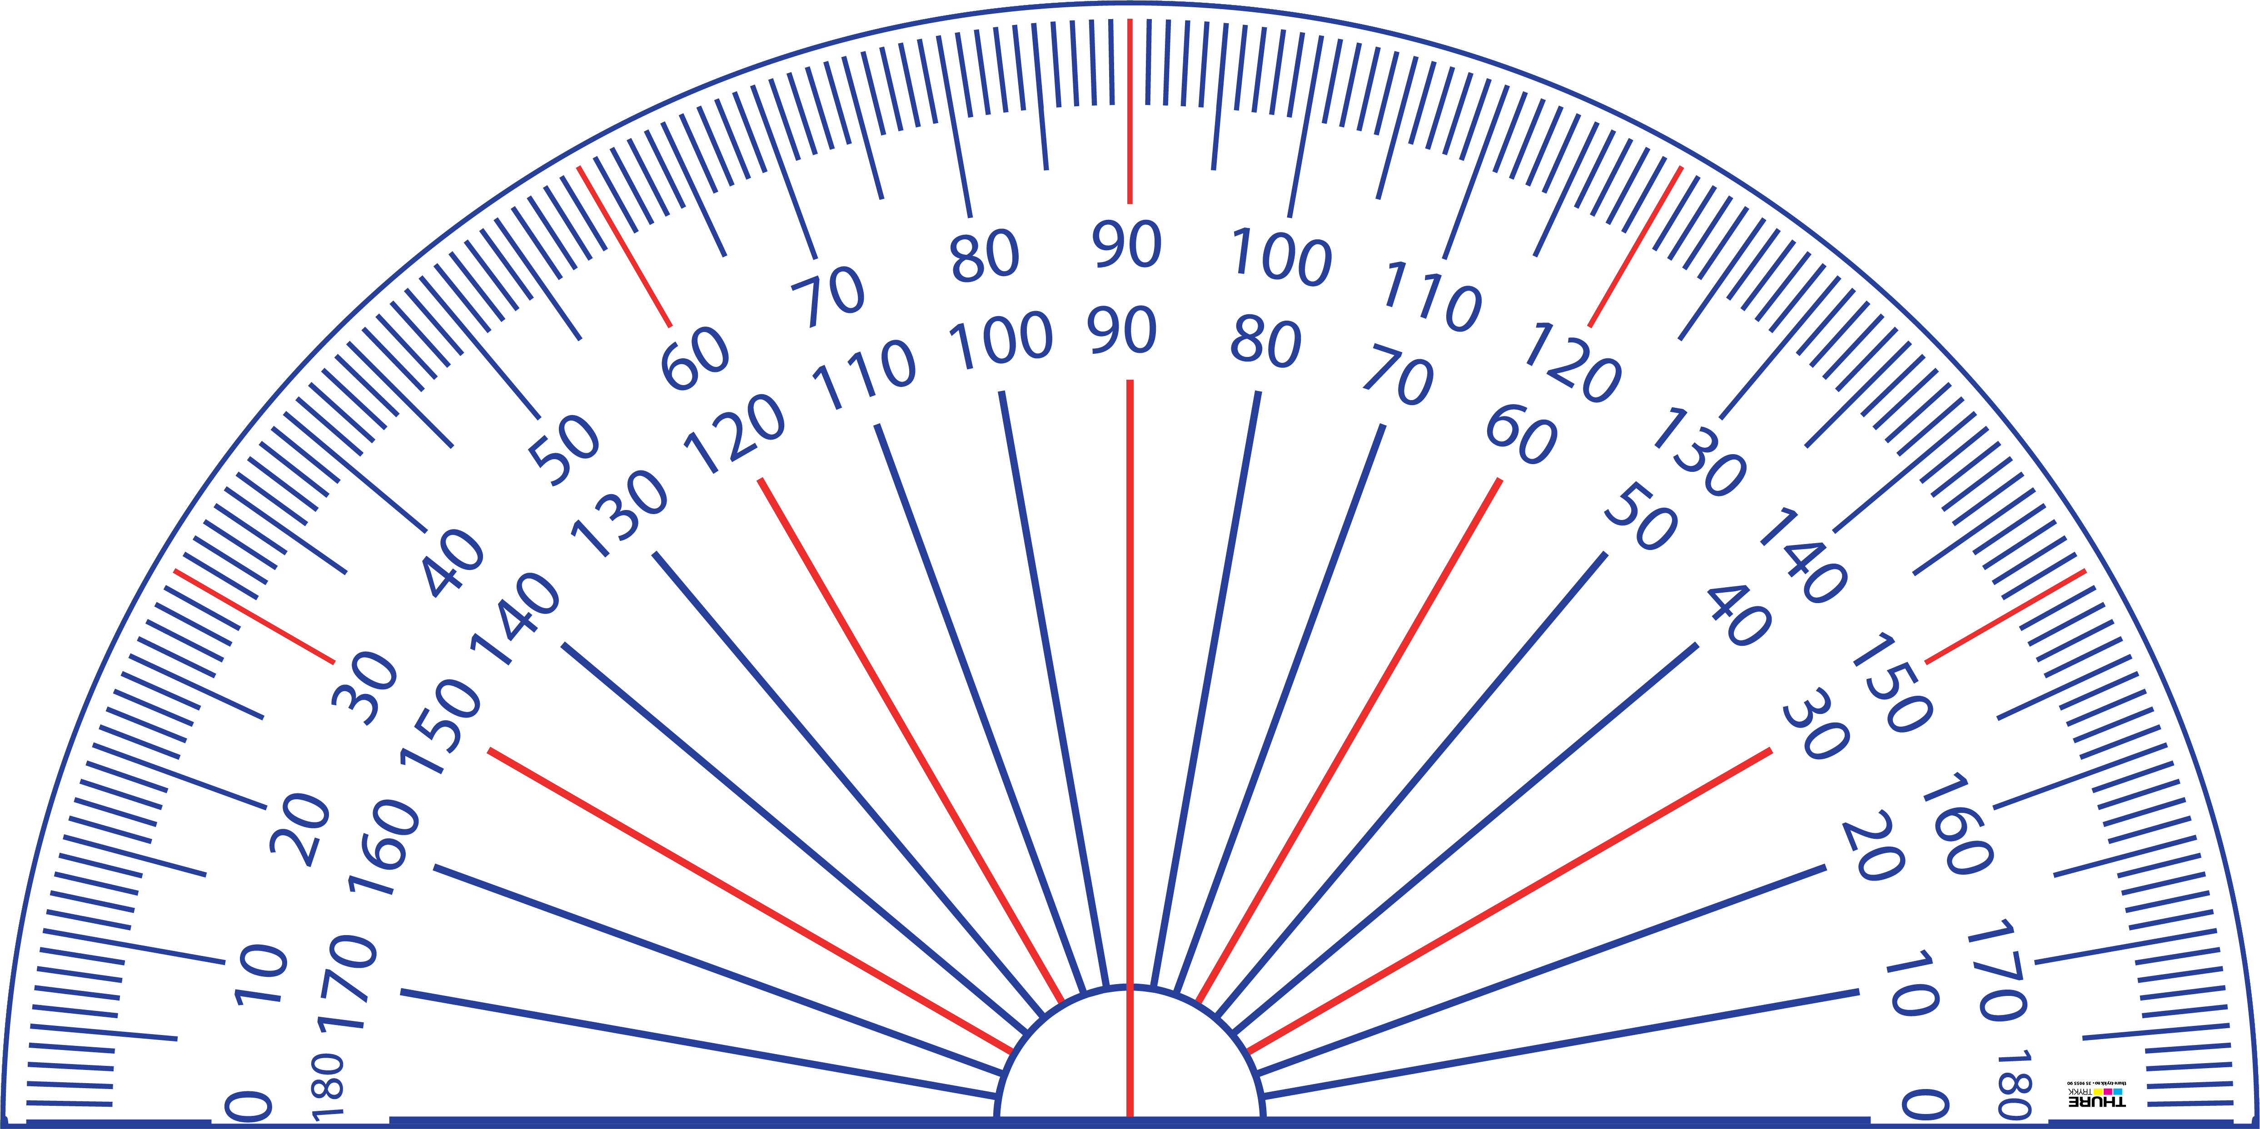








De faktiske vinklene vi måler (i mikrofon-trekanten)
90˚
75˚
1
170˚
10˚
180˚
0˚
2
3
-35˚
-120˚
-65˚
-90˚

Slide 12
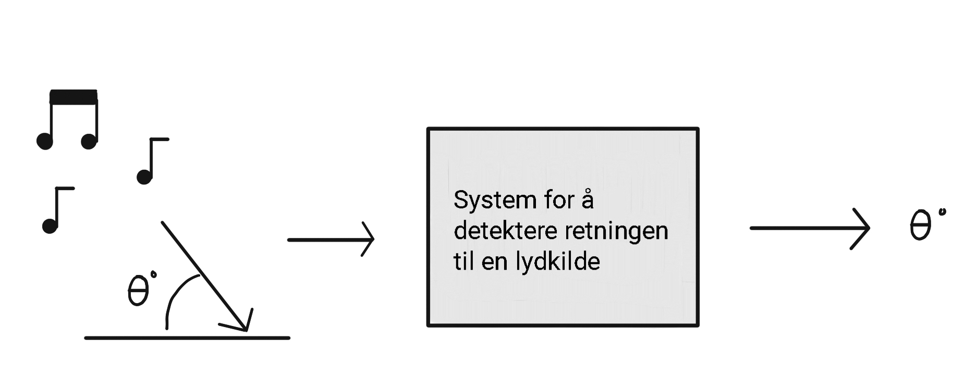



System for å detektere
retningen til en lydkilde

